Slide 1
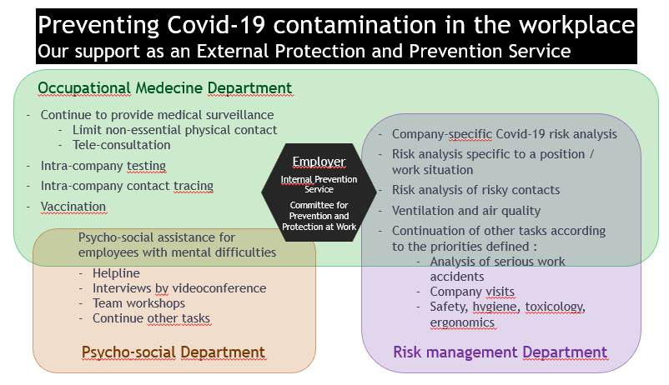
Preventing Covid-19 contamination in the workplace Our support as an External Protection and Prevention Service during the Covid-19 pandemic
Authors : Dr Pête E., Dr Kus G., Dr Haemers E. | Attentia, Prevention and External Protection Service
Feedback and lessons after 2 years of “health crisis” management linked to the Covid-19 pandemic
Objective : Preventing Covid contamination in the workplace
Challenges
Preventing the spread of the virus in the workplace
Allow professional activities to continue, and avoid work stoppages in case of the spread of the virus
Respond quickly with a uniform and structured approach in the case of contamination, change in the health situation, new government decisions, or specific situations within the company
Protect and provide an effective response to the concerns of employees at risk of Covid-19 contamination in the workplace
How to prevent Covid-19 contamination in a company ?
Our support as External Protection and Prevention Service
Eliminate the risk
Télé-working : made compulsory by the government
(when it is possible to work remotely)
Apply physical measures
Physical distancing
Implement organizational measures
Use collective / personal equipment to protect against Covid-19
Apply barrier gestures
Reinforced hygiene measures in the workplace
Limit physical interactions, meetings or interviews
Ventilation and air quality
Implement means of screening for Coronavirus SARS-Cov-2 in the workplace Intra-company contact tracing
Occupational Physician’s essential role in the fight against the SARS-Cov-2 pandemic has been formalized :
by the government (Royal Decree of January 5, 2021)
as well as by the unanimous opinion of the social partners of March 23, 2021 concerning the implementation in companies of rapid tests on a repetitive basis
Conclusion : We insist on the necessary interdependence and collaboration with company stakeholders and experts within Internal and External Protection and Prevention Services
References cited :
- Royal Decree of March 28, 2021 making mandatory the collective labor agreement n° 149 of January 26, 2021, concluded within the National Labor Council, concerning recommended or mandatory telework due to the coronavirus crisis.
- Royal Decree of January 5, 2021 regarding the role of the Occupational Physician in the fight against the SARS-Cov-2 coronavirus.
- The unanimous opinion of the social partners of March 23, 2021 concerning the implementation in companies of rapid tests on a repetitive basis.
Notes:
To change this poster, replace our sample content with your own. Or, if you'd rather start from a clean slate, press the New Slide button on the Home tab to insert a new page. Now enter your text and pictures in the empty placeholders. If you need more placeholders for titles, subtitles or body text, copy any of the existing placeholders, then drag the new one into place.

